Slide 1
COMP90018 Mobile Computing Systems Programming
Prof. Vassilis Kostakos

Slide 2
Location-based Services
Nearest neighbor queries
Heart patient continuously monitors the closest hospitals
Monitoring for traffic applications
Immediate warnings about oil spills or icy patches
Location-aware social networking
Finding friends (Foursquare, Google Latitude, Gowalla, Loopt, …)
Location-based advertising
Send 20% off coupons to all mobile devices close to a store (range query)

Slide 3
Privacy Concerns …
IEEE Spectrum, July 2003
“They know where you are: new technologies can pinpoint your location at any time and place. They promise safety and convenience – but threaten privacy and security.”
Lack in privacy-aware systems
Might inhibit the growth of location-based services

Slide 4
Location Privacy
Status quo of current mobile systems
Able to continuously monitor, communicate, and process information about a person’s location
Have a high degree of spatial and temporal precision and accuracy
Might be linked with other data
Important research issue
Techniques for protecting location privacy are required

Slide 5
The Importance of Location Privacy
Location-based spam
Unsolicited advertising
Personal safety
Stalking
Assault
Intrusive inferences
Person’s political views
Individual preferences
Health conditions

Slide 6
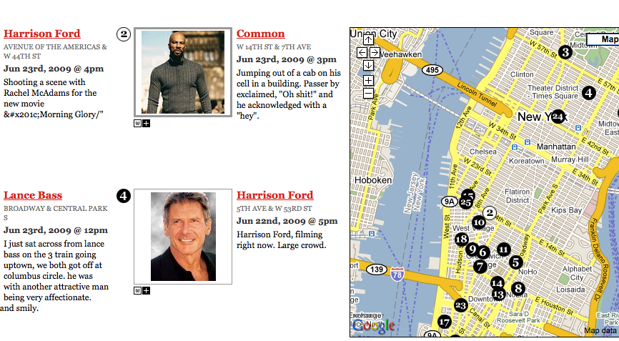
Sightings of Celebrities in Real-Time
http://gawker.com/stalker (not active anymore)

Slide 7
Tracking of Individuals
Deutsche Telekom (telecommunication operator)
Deutsche Telekom handed over six months of Malte Spitz’s phone data
Tracked position, phone calls, SMS, Internet access
http://www.zeit.de/datenschutz/malte-spitz-data-retention

Slide 8
Do people care about location privacy?

Slide 9
Study about Rendezvousing
Study of Colbert, 2001
Friend finding:
Asked participants to estimate the number of people with whom they would have long-standing agreements to obtain position information or permit their position to be obtained
Participants: 17 male and 17 female students
Results
Many students had at least 10 individuals on their lists!
Colbert questioned their accuracy
Participants might have different or unstated expectations about the possible, future use of this service

Slide 10
User Needs for Location-Aware Mobile Services
Study of Kaasinen, 2001
Participants: 55 people from different backgrounds
Group interviews
Results
Worried about their privacy and evoked ‘‘big brother’’ association for services that locate people
But: not worried about their privacy using location-aware services
Most people did not realize that they can be located using location-aware services
Trust in regulations for mobile phone operators

Slide 11
How much is Location Privacy Worth?
Study of Danezis et al., 2005
Collection of precise location information (via a mobile phone) for a (fictional) study running for one month
Competition auction: participants state their required monetary compensation
Participants: 74 undergraduate computer science students
Results
Median price: £10; £20 pounds if data is used commercially
Two people lost interest if the data is commercially used
9 people asked for more than £30

Slide 12
Gathering GPS Data from Drivers
Krumm’s Study, 2007
Convinced more than 250 people from Microsoft to provide recorded GPS data for two weeks
Incentive: a 1 in 100 chance of winning a $200 MP3 player
97 of them were asked if the data could be used outside Microsoft and only 20% denied this

Slide 13
Privacy Concerns: Presence Services
Survey by Harris Interactive, 2006: 1028 adults, online
Do you believe any of these types of services are an invasion of privacy?
Presence service | Yes
The ability to look at your contact list and determine if they were available to talk, busy on a call or unavailable. | 34%
The ability for friends and family to see this information about you. | 59%
The ability to determine the location of persons on your contact list (snapshot of where they are now). | 70%
The ability to determine what locations individuals on your contact list were over the last few hours (map of their whereabouts). | 73%
The ability for your employer to see this information about you. | 83%
None of these | 10%
Source: http://www.harrisinteractive.com/news/allnewsbydate.asp?NewsID=1184

Slide 14
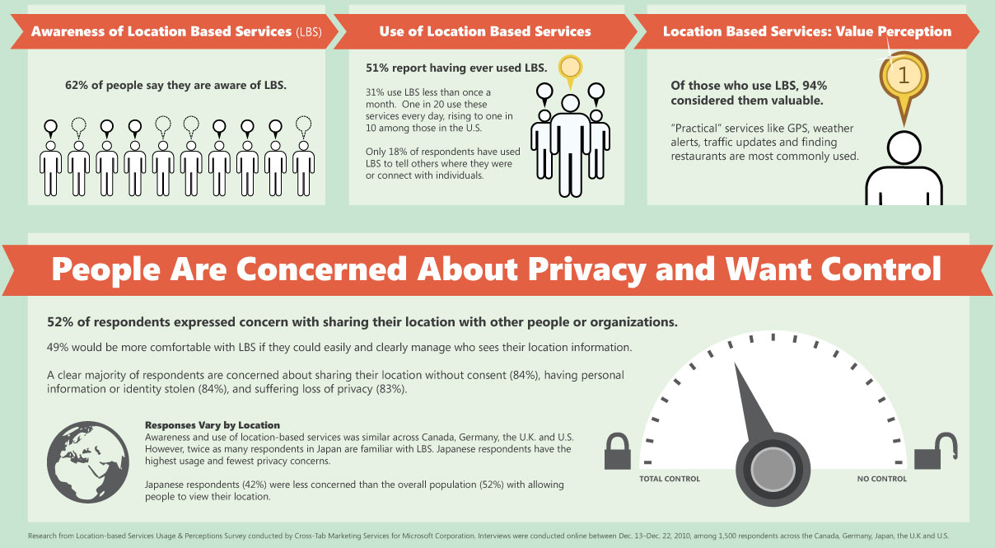
Microsoft in 2011 (Data Privacy Day)

Slide 15
Techniques for Location Privacy

Slide 16
Stealth
Stealth
Ability to be at a location without anyone knowing you are there
How
Use of passive devices such as GPS
Disadvantages
Active devices such as mobile phones cannot preserve stealth
Access of information overrides stealth

Slide 17
Anonymity-Based Approaches
Idea
Separate location information from an individual’s identity
Special type is pseudonymity: an individual is anonymous but has a persistent identity (a pseudonym)
Disadvantages
Vulnerability to data mining: a person’s identity can be inferred from his or her location over time, in particular from homes or offices
A barrier to authentication and personalization
Efficacy in sparsely populated areas?

Slide 18
K-Anonymity
Sweeney (2000)
Analysis of microdata
Anonymized health records: DOB, Gender, ZIP code
Uniquely identified medical records of the governor of Massachusetts => DOB, Gender, ZIP code are quasi identifiers
~87% of population can be identified!
Databases: k-anonymity (Sweeney 2002)
A table is k-anonymous if every record in the table is indistinguishable from at least k − 1 other records with respect to quasi identifiers

Slide 19
Anonymity: Cloaking
Spatial cloaking
Gruteser & Grunwald use quadtrees
Adapt the spatial precision of location information about a person according to the number of other people in the same quadrant
k-anonymity
Individuals are k-anonymous if their location information cannot be distinguished from k−1 other individuals
Temporal cloaking
Reduce the frequency of temporal information

Slide 20
Spatial Cloaking (k_{min} = 4)

Slide 21



Basic Model
Wireless Network
Location
Location and query
Location Server (Cloaking algorithms)
Anonymous data: location, time of query
Response
Location Based Service Provider

Slide 22
Location Privacy through Obfuscation

Slide 23
Workshop on Location-aware Computing
I would be happy if a third party who I sometimes do business with knew my location on a Saturday afternoon’s shopping trip to an accuracy of (pick all that apply):
None at all: 96%
Existence but no accuracy: 43%
Country: 35%
City: 35%
Street: 17%
10m: 13%
1m: 4%
1cm: 4%
People are more prepared to reveal their location to some degree the less precise the location is

Slide 24
Obfuscation
Idea
Mask an individual's precision
Deliberately degrade the quality of information about an individual’s location (imperfect information)
Identity can be revealed
Assumption
Spatial imperfection ≈ privacy
The greater the imperfect knowledge about a user’s location, the greater the user’s privacy

Slide 25
Motivation for Obfuscation
Finding the closest Sushi restaurant
Location-based service provider
Ichiban
A: Sushi Ten
Sushi Ten
Q: I am in Princess park.
What is the closest Sushi
restaurant?
Yo! Sushi
Visitor
Princess Park

Slide 26
Strategies for Imperfection
Types of imperfection
Accurate and precise: l ∈ O and |O| = 1
Inaccurate and precise: l ∉ O and |O| = 1
Accurate and imprecise: l ∈ O and |O| > 1
Inaccurate and imprecise: l ∉ O and |O| > 1
Consequences
The larger O, the less information is revealed about the true location l
The greater the level of privacy
The greater the distance between O and the true location l
The greater the level of privacy

Slide 27
Example Obfuscation Set
Obfuscation set
O = {a,c,h,m,n,o,w} does not need to be contiguous
An individual is located at one of the vertices in O

Slide 28
Obfuscation Algorithm
Input of the Algorithm
Weighted graph G = (V, E) representing the geographic environment
Obfuscation set O ⊆ V of the client’s location l ∈ O
Points of interest Q ⊆ V
Output of the Algorithm
Pair ⟨q, C⟩, C ∈ (0, 1] is the confidence that q ∈ Q is the nearest target to the client’s current location

Slide 29
Prerequisites
Definitions
d(v₁, v₂) is the shortest path distance of v₁, v₂ ∈ V in G
Nearest point of interest:
NP : O → Q, o |→ q such that ∀q′ ∈ Q [d(o, q) ≤ d(o, q′)]
(assumption: d(o, q₁) = d(o, q₂) ⇒ q₁ = q₂)
Equivalence relation
δ⊆O×O: o₁ δ o₂ ⇔ NP(o₁) = NP(o₂)

Slide 30
Negotiation Algorithm (NN Queries)
Data: G = (V,E), O, Q
Result: ⟨q, C⟩
Construct the partition O/δ;
if O ∈ O/δ then
Return ⟨q, 1.0⟩ with q = NP(o) for an arbitrary o ∈ O;
else
if Client identifies current location l as equivalence class [l] ∈ O/δ then
Return ⟨q, 1.0⟩ where q = NP(o) for an arbitrary o ∈ [l];
else
if Client identifies a new obfuscation O′ ⊂ O then
Reiterate algorithm with O′ in place of O;
else
Return ⟨q, C⟩ with C = |[o]|/|O| ∧ q = NP(o) for some o ∈ O such that C is maximized;

Slide 31
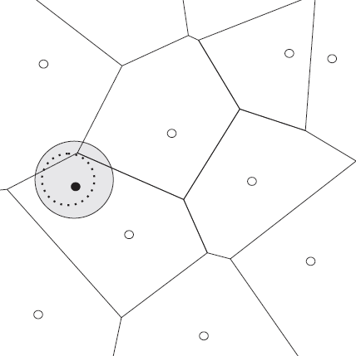
Visualizing the Algorithm

Slide 32
How to Compute δ
Naive Approach
Compute the shortest path from every element of O to every element of Q
Complexity of a single source shortest path algorithm (Dijkstra): O(n²)
In each step: O(|O|n²), i.e. if |O| approaches n: O(n³)
Our approach
Introduce a dummy vertex such that every POI is the second vertex
Compute all the shortest paths on the new graph
Complexity per step: O((n + 1)²) = O(n²)

Slide 33
Computing δ Using Dijkstra

Slide 34
L-Diversity I
Homogeneity attack
31-year-old American who lives in the zip code 13053
Background attack
21 year old Japanese in 13068; Japanese are unlikely to have a heart disease
 | Non-Sensitive |  |  | Sensitive
 | Zip Code | Age | Nationality | Condition
1 | 13053 | 28 | Russian | Heart Disease
2 | 13068 | 29 | American | Heart Disease
3 | 13068 | 21 | Japanese | Viral Infection
4 | 13053 | 23 | American | Viral Infection
5 | 14853 | 50 | Indian | Cancer
6 | 14853 | 55 | Russian | Heart Disease
7 | 14850 | 47 | American | Viral Infection
8 | 14850 | 49 | American | Viral Infection
9 | 13053 | 31 | American | Cancer
10 | 13053 | 37 | Indian | Cancer
11 | 13068 | 36 | Japanese | Cancer
12 | 13068 | 35 | American | Cancer
 | Non-Sensitive |  |  | Sensitive
 | Zip Code | Age | Nationality | Condition
1 | 130** | < 30 | * | Heart Disease
2 | 130** | < 30 | * | Heart Disease
3 | 130** | < 30 | * | Viral Infection
4 | 130** | < 30 | * | Viral Infection
5 | 1485* | ≥ 40 | * | Cancer
6 | 1485* | ≥ 40 | * | Heart Disease
7 | 1485* | ≥ 40 | * | Viral Infection
8 | 1485* | ≥ 40 | * | Viral Infection
9 | 130** | 3* | * | Cancer
10 | 130** | 3* | * | Cancer
11 | 130** | 3* | * | Cancer
12 | 130** | 3* | * | Cancer

Slide 35
L-Diversity II
l-Diversity Principle
A q*-block is l-diverse if contains at least l “well-represented” values for the sensitive attribute S.
A table is l-diverse if every q*-block is l-diverse.
An attacker needs l-1 damaging pieces of background knowledge to eliminate all l-1 possible sensitive values
LBS
POI or content of queries
 | Non-Sensitive |  |  | Sensitive
 | Zip Code | Age | Nationality | Condition
1 | 1305* | ≤ 40 | ∗ | Heart Disease
4 | 1305* | ≤ 40 | ∗ | Viral Infection
9 | 1305* | ≤ 40 | ∗ | Cancer
10 | 1305* | ≤ 40 | ∗ | Cancer
5 | 1485* | > 40 | ∗ | Cancer
6 | 1485* | > 40 | ∗ | Heart Disease
7 | 1485* | > 40 | ∗ | Viral Infection
8 | 1485* | > 40 | ∗ | Viral Infection
2 | 1306* | ≤ 40 | ∗ | Heart Disease
3 | 1306* | ≤ 40 | ∗ | Viral Infection
11 | 1306* | ≤ 40 | ∗ | Cancer
12 | 1306* | ≤ 40 | ∗ | Cancer

Slide 36
Decentralized Approach to Location Privacy

Slide 37
Centralized Approaches
Mobile Agent
LSP
Query with exact location
Query with imprecise location
Trusted Server
Precise result
Result set
Limitations
Communication overheads
Security threats
Single point of failure

Slide 38
Do Not Trust Anyone: Go Decentralized!
Idea
Use WPANs (spontaneous local ad-hoc networks), e.g. Bluetooth or 802.11
Clique: form spontaneous local ad-hoc networks that are wirelessly connected
Do not disclose your precise position to anyone (obfuscation) including your neighbors
Be k-anonymous to your location-based service provider
Two roles
Hide service request from mobile phone operator, i.e., separate an agent's request (query requestor) from the agent requesting this service (query initiator)

Slide 39
Decentralized Approach
Locally cloaked area (LCA)
Represents imprecise location using obfuscation
Periodically broadcast to neighbors
Globally cloaked area (GCA)
Obfuscation: query requestor computes its obfuscated area using the LCAs of its neighbors
Selection
Anonymity: query initiator randomly selects a query requestor to forward its request to the LSP

Slide 40
Locally Cloaked Area (LCA)
Agent specification
Area
Parameter affecting ratio of length and width
Parameter for the agent’s position relative to area’s boundary
LCA
Rectangle is described by (x_{min}, x_{max}, y_{min}, y_{max})

Slide 41
Globally Cloaked Area (GCA)
GCA computation
An agent specifies anonymity level k and a required minimum area
Requests LCAs from its neighbors
Geometric problem
Find the minimum bounding box of a k-subset (including the agent’s own LCA) from n possible LCAs

Slide 42
Approximating the GCA (1)
Eliminate the rectangle whose edge has the greatest distance to the closest edge of the agent’s rectangle

Slide 43
Approximating the GCA (2)
Evaluate pairs of rectangles: those with the first and second maximum for x_{min}, x_{max}, y_{min}, y_{max}, respectively
Compute the distance for each pair
Eliminates the rectangle that maximizes the distance

Slide 44
Approximating the GCA (3)
Similar to the second criterion
Eliminate the maximum area to be discarded from the current GCA

Slide 45
Random Selection
Problem
How to select a query requestor if the hop distance is greater than 1?
Anonymous selection algorithm
We propose a near-uniform random selection process for a query initiator to select a query requestor
Even from agents that are not in communication range
Without disclosing the IDs of the involved agents

Slide 46



Random Selection
Query Requestor
Query Initiator

Slide 47
Frequency Computation
Broadcasting message (query initiator)
Unique message ID
Count initialized to 1
Hop count initialized as the maximum hop count
 | 0 |  | 0 | 0 |  | 0
0 | 0 |  |  | 0 | 0
 |  | 1 |  | 1 |  | 0
 | 0 | 1 | 1 |  | 0 | 0
 | 0 | 1 |  | 1 | 0
0 | 0 | 0 |  | 0 | 0
0 |  |  | 0 | 0 | 0
 | 0 |  | 0 | 0 |  | 0
0 | 1 |  |  | 1 | 1
 |  | 3 |  | 2 | 0 | 0
 | 3 | 4 | 6 |  | 2 | 0
 | 2 | 3 |  | 2 | 1
0 | 1 | 1 |  | 1 | 1
0 |  |  | 0 | 0 | 0
 | 1 |  | 1 | 2 |  | 1
1 | 4 |  |  | 4 | 4
 |  | 17 |  | 12 |  | 3
 | 15 | 21 | 20 |  | 7 | 3
 | 14 | 20 |  | 13 | 7
3 | 7 | 7 |  | 5 | 5
1 |  |  | 2 | 2 | 2

Slide 48
Naïve Versus Near-Uniform Selection
 | 0.83 |  | 0.67 | 1.22 |  | 0.56
0.83 | 2.61 |  |  | 2.44 | 2.44
 |  | 9.09 |  | 6.36 |  | 1.57
 | 7.23 | 10.12 | 9.84 |  | 3.63 | 1.48
 | 6.32 | 9.22 |  | 6.16 | 3.27
1.13 | 2.74 | 2.74 |  | 2.25 | 2.25
0.40 |  |  | 0.87 | 0.86 | 0.86
 | 3.47 |  | 2.53 | 2.35 |  | 2.18
3.47 | 5.22 |  |  | 3.31 | 3.31
 |  | 4.93 |  | 2.91 |  | 2.11
 | 5.54 | 4.79 | 4.23 |  | 3.39 | 2.60
 | 5.25 | 4.55 |  | 2.85 | 2.79
3.49 | 4.01 | 4.01 |  | 3.08 | 3.08
2.67 |  |  | 3.51 | 2.18 | 2.18

Slide 49
Secure Communication
Query initiator sends a message including its public key and the service request (encrypted using the public key of the LSP)
Query requestor sends the encrypted message to the LSP
LSP decrypts the message with its private key
LSP encrypts the requested information using the public key of the query initiator
LSP broadcasts the encrypted message in the query initiator’s GCA

Slide 50
Privacy Preserving Group NN Queries

Slide 51
Privacy Preserving k-GNN Queries
K-group nearest neighbor queries
Returns the location of a meeting place that minimizes the aggregate distance (SUM or MAX) for a group of users
Example: find a restaurant with the smallest travel distance (SUM) or time (MAX) for friends located at different positions
Challenge
Do not reveal exact locations to the location service provider and not even to your friends!

Slide 52
Private Group Nearest Neighbor Queries
How do we find the actual group nearest neighbor without revealing the locations of users to others?
How do we efficiently evaluate group nearest neighbor queries with respect to a set of rectangles?
p₅
l₅
l₁
p₄
p₁
l₂
l₄
p₇
p₃
p₂
p₆
l₃
p₈

Slide 53
Distance Intersection Attack I
u₁’s location is identified!
 | p₁ | p₂ | p₃ | p₄ | p₅ | p₆ | p₇ | p₈
u₁ | 3 | 8.5 | 9 | 3.5 | 4.5 | 11.5 | 13.5 | 14
u₂ | 2 | 7.5 | 8.5 | 3.5 | 8.5 | 7.5 | 14.5 | 12
u₃ | 11 | 5 | 5.5 | 15 | 15.5 | 9 | 9 | 2
u₄ | 6 | 3.5 | 2 | 10 | 8.5 | 11 | 6.5 | 9
u₅ | 12.5 | 10.5 | 8.5 | 15.5 | 10 | 18.5 | 5 | 15.5
p₅
Group nearest neighbor
l₅
l₁
p₄
p₁
l₂
l₄
Distances from users to data objects
3
p₇
p₃
 | p₁ | p₂ | p₃ | p₄ | p₅ | p₆ | p₇ | p₈
u₁ | 3 | 8.5 | 9 | 3.5 | 4.5 | 11.5 | 13.5 | 14
u₂ | 5 | 16 | 17.5 | 7 | 13 | 19 | 28 | 26
u₃ | 16 | 21 | 23 | 22 | 28.5 | 28 | 37 | 28
u₄ | 22 | 24.5 | 25 | 32 | 37 | 39 | 43.5 | 37
u₅ | 34.5 | 35 | 33.5 | 47.5 | 47 | 57.5 | 48.5 | 52.5
p₂
9
8.5
p₆
l₃
p₈
Updated distances after adding each user’s actual distance to the data objects

Slide 54
Distance Intersection Attack II
Distance intersection attack
If a user’s distances from three or more data objects are revealed, the user’s location is the intersection point of all circles
 | p₁ | p₂ | p₃ | p₄ | p₅ | p₆ | p₇ | p₈
u₁ | 3 | 8.5 | 9 | 3.5 | 4.5 | 11.5 | 13.5 | 14
u₂ | 2 | 7.5 | 8.5 | 3.5 | 8.5 | 7.5 | 14.5 | 12
u₃ | 11 | 5 | 5.5 | 15 | 15.5 | 9 | 9 | 2
u₄ | 6 | 3.5 | 2 | 10 | 8.5 | 11 | 6.5 | 9
u₅ | 12.5 | 10.5 | 8.5 | 15.5 | 10 | 18.5 | 5 | 15.5
Distances from users to data objects
 | p₁ | p₂ | p₃ | p₄ | p₅ | p₆ | p₇ | p₈
u₁ | 3 | 8.5 | 9 | 3.5 | 4.5 | 11.5 | 13.5 | 14
u₂ | 5 | 16 | 17.5 | 7 | 13 | 19 | 28 | 26
u₃ | 16 | 21 | 23 | 22 | 28.5 | 28 | 37 | 28
u₄ | 22 | 24.5 | 25 | 32 | 37 | 39 | 43.5 | 37
u₅ | 34.5 | 35 | 33.5 | 47.5 | 47 | 57.5 | 48.5 | 52.5
Updated distances after adding each user’s actual distance to the data objects

Slide 55
Solution: Use Aggregate Information
LSP
Set of candidate data objects
For each candidate data object p_{h}:
d_{max}(p_{h}) = ∑_{i=1…n} MaxDist(R_{i}, p_{h})
User
u_{i} computes d'_{max}(p_{h}) for p_{h} and updates d_{max}(p_{h}) d_{max}(p_{h}) ← d_{max}(p_{h}) - MaxDist(R_{i}, p_{h}) + Dist(l_{i}, p_{h})
After all updates
d_{max}(p_{h}) represents the total distance of p_{h} to the group: d_{max}(p_{h}) = ∑_{i=1…n} Dist(l_{i}, p_{h})
R_{i} = User u_{i}’s rectangle (imprecise location)
l_{i} = User u_{i}’s precise location

Slide 56
Attacks to Location Privacy

Slide 57
Query Sampling Attack
Assumptions
Positions (but not identities) are known
User choice: smallest region for best QoS
Attack
Outliers are easily identified
A
B
C
R₁
D
R₂
E
F
R₃
Users | k-Level | Region
A | 3 | R₁
B, C | 3 | R₂
D, E, F | 3 | R₃

Slide 58
Query Tracking Attack
Assumptions
Continuous query
Positions (but not identities) are known
Persistent pseudonym during updates
Attack
Intersection of candidate lists
A
A
I
B
H
C
G
D
F
J
E
A
Time | Candidate List
t₀ | A, B, C, D, F
t₁ | A, B, G, H, I
t₂ | A, D, E, G, J

Slide 59
Maximum Movement Boundary Attack
Assumptions
Continuous query
Maximum possible speed
Same pseudonym during two consecutive updates
Attack
Maximum speed defines possible locations
Intersect MMB (maximum movement boundary) with updated query rectangle
MMB
R_{i}
R_{i+1}

Slide 60
Query Trajectory Attack
Assumptions
Continuous query
Continuous updates necessary to ensure result is correct
Attack
Intersect rectangles of two consecutive updates to refine the user location
R_{i}
R_{i+1}

Slide 61
Context Inference (Outdoor)
Patterson et al.
GPS traces to infer in real-time a person's mode of transportation: foot, bus, car
Prediction of their future route based on their history
Enables privacy attacks on likely future locations
Krumm
Inference attacks on 172 GPS traces
Correct computation of home address: 12%
Correctly revealed identity via reverse lookup: 5%

Slide 62
Context Inference (Indoor)
PEPYS (Newman et al.)
Based on an indoor location sensing in offices
Filters to find significant events like gatherings of multiple people
Matsuo et al.
Based on indoor location sensing
Inference of properties about people based on their visited locations:
Age
Work role, work frequency, …
Coffee/tea drinker, smoker, …

Slide 63
Privacy Preserving Moving NN Queries

Slide 64
Moving kNN Queries
Moving k Nearest Neighbor Queries
Continuously returns the locations of k nearest data objects with regard to a moving query point
Scenario: the user reveals her identity for personalized service
Privacy Risks
Continuous update of locations reveals a user’s trajectory
: Moving query point
: Restaurants

Slide 65
Combined Attack
R₁
M_{1,2}∩R₂∩R₃
M_{1,2}
R₂
R₃
R₄

Slide 66
Problem Setup
Confidence level
Provides a user with an option to trade the accuracy of the query answers for trajectory privacy
Guarantees that the distance of the data object to the user’s location is within a bound of the actual nearest data object’s distance
Idea
Pay more: ask for a larger k
Travel more: confidence level cl (travel at 1/cl)

Slide 67
Confidence Level

Slide 68
Computing Consecutive Rectangles
Key Idea
Specify higher values for confidence level or the number of nearest data objects (i.e., k) or both
Not reveal the required ones
An algorithm to compute the user’s consecutive rectangles
Resists the overlapping rectangle attack
Prevents the identification of the user’s trajectory
Efficient evaluation of a kNN query with respect to a rectangle and a specified confidence level

Slide 69
Private Data Exchange

Slide 70
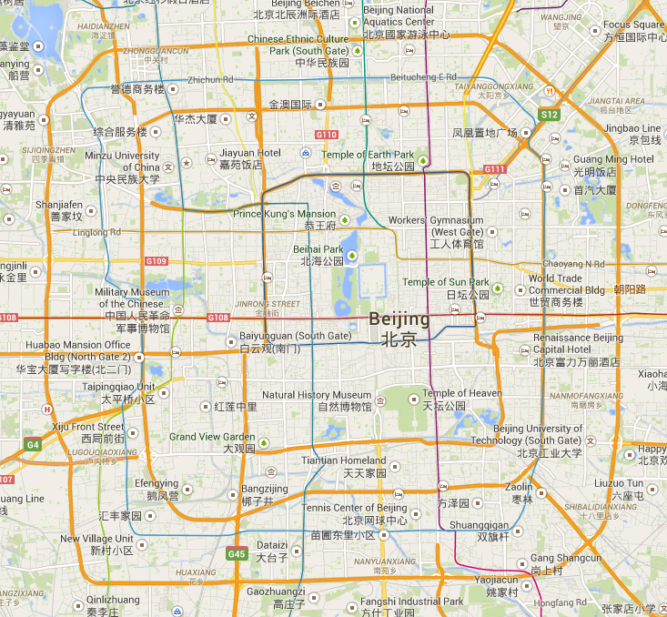
Tell Me What You Want And I Will Tell Others Where You Have Been
Data sanitization
Protection of privacy through removal of GPS tracks
Attacker Model
Sampled GPS Points
POI
Edge Centrality: | The more central an edge, the more frequently it occurs in a set of paths
Edge Frequency: | The adversary may have access to the trips users have take in the past
Maximum Velocity: | The adversary may assume there is a maximum velocity a user can travel

Slide 71
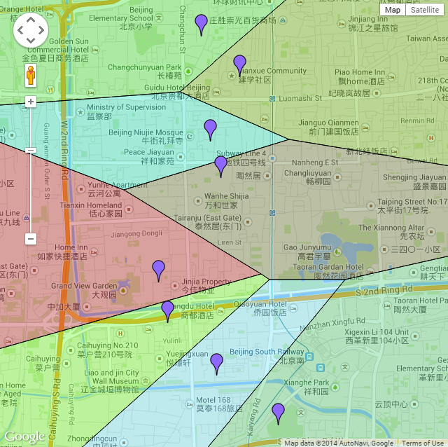
Experiments using POI Datasets
Dataset
Use of Beijing routes from Microsoft’s Geolife dataset for performance evaluation
Road network data was from OpenStreetMap
Evaluation
Proximity circles were varied 50, 100, 250, 500 meters
POI | r = 50m (%) | r = 100m (%) | r = 250m (%) | r = 500m (%)
400 | 27.73 | 39.10 | 51.83 | 64.74
800 | 35.10 | 47.97 | 61.31 | 73.76
1,600 | 39.00 | 53.90 | 69.63 | 80.84

Slide 72
Sensitive Trajectory Datasets
Spatial and temporal exchange
Aim: preserve privacy prior to exchanging trajectory datasets
Focuses stops as a trip can better be learnt from stops
Less data distortion due to local (partial) changes
Resilient to inference attacks
Exchanges sensitive stops with less sensitive POIs
Balances trajectory privacy against data utility
Displacement
Stop Sensitivity
Location Type
Stop Duration
Road network
Actual footprint
POIs with high sensitivity
POIs with moderate sensitivity
POIs with low sensitivity
Replacement
Notes:
Balances trajectory privacy against data utility

Slide 73
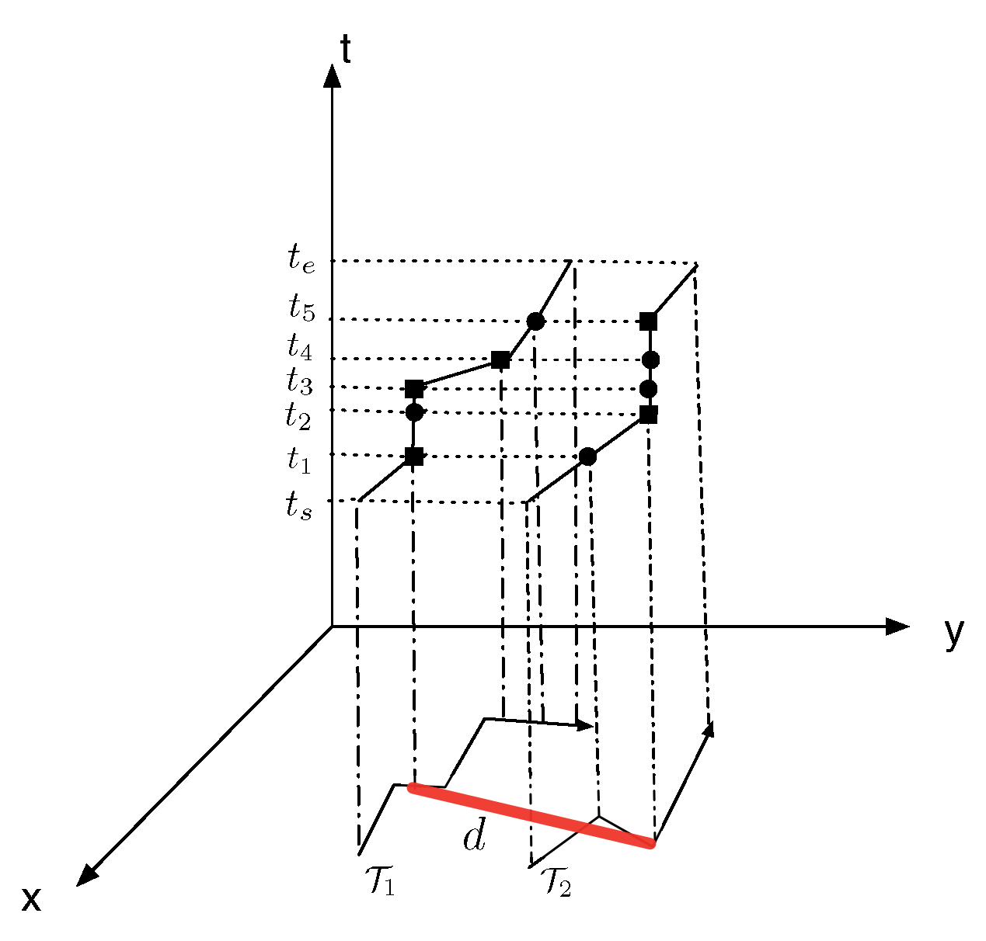
Measuring Privacy and Utility
The sensitivity of a stop
Place sensitivity rank r_{p}, the duration of a stop d_{s}, and the total duration of a trip d_{t}
Privacy and utility
max_{sd} is the maximum sensitivity deviation for the k least sensitive POIs

Slide 74
Negative Information

Slide 75
Monitoring Moving Objects
Applications
Discovering movement patterns in shopping malls
Monitoring traffic
Aggregate query processing
Summarized information from a number of locations for more than one moving object
Examples
Number of distinct entries to a shopping mall
Traffic between two suburbs
Traffic on a ring road

Slide 76
What is Negative Information?
Negative representation of data
Any category except the true category
Proposed by Esponda (2004)
Example
OR
OR
Given a set of 4 colors
Positive information: actual color of an object
Negative information: any color but the true color

Slide 77
Negative Information for Privacy
Privacy
Number of categories for negative information is much larger than for positive information
Scenario: wireless sensor networks
Each sensor picks a negative category from t categories
Reported counts for all categories are R₁, R₂, …, R_{t}
If n is the total number of reports, the actual count of category i is estimated as
A_{i} = n – (t – 1) R_{i}

Slide 78
Estimating Average Velocity
Speed readings
Divided into categories: 0 – 10 km/h, 10 – 20 km/h, …
Each sensor randomly picks a category that is NOT cover the true value
System counts the reported category
Based on the counts, system estimates the true count of each category
Traffic jam
No counts in the category 0 – 10 km/h!

Slide 79
Metrics for Location Privacy

Slide 80
What is a Good Metric?
No agreement in the community on the x-axis!
QoS
Location privacy
Anonymity set, obfuscation set, entropy, …

Slide 81
Anonymity Sets
Definition (by Chaum)
The set of all possible subjects who might cause an action. (following Chaum for anonymous communications)
Location privacy: action is requesting a LBS
Properties
The larger the size of the set, the greater the anonymity
Example for location privacy: k-anonymity
Assumes all subjects are equally important!
Only true if pseudonyms are unlinkable

Slide 82
Obfuscation Sets
Definition (by Duckham and Kulik)
The locations from which a user’s position is indistinguishable/indiscernable
The user location is element of this set
Properties
Location privacy is measured by the cardinality of the set
The larger the size of the set, the greater the location privacy

Slide 83
Distance Measures
Definition (by Hoh and Gruteser)
Location privacy is the distance between a user’s location and the estimated location
Properties
Works well is user’s report a false or dummy locations

Slide 84
Entropy
Shannon: Information theory (1948)
Measure for the average information content
The less likely a character (element), the higher its information content
Application to location privacy (Beresford and Stajano)
Entropy is maximal if all users (elements) are of equal interest to an attacker
Accounts for additional knowledge by conditional probabilities
Information content: knowledge about previous travel patterns such as the likelihood of a U-turn to link pseudonyms

Slide 85
Navigation Under Imprecision

Slide 86
Navigation under Imprecision
Assumption
An agent’s location cannot be precisely determined
Contingency Strategy
Search for an instruction sequence that improves an agent’s chances of reaching its destination
Evaluate different paths from a given position to a destination location and select the one that fits as many routes as possible
Goal: Find a maximal set of instruction-equivalent paths

Slide 87
Contingency Strategy
Instruction sequence
Turn right at the next intersection
Evaluation
Only 1 of 3 instruction-equivalent paths leads to the destination
Beaupré
Beauport
Charlesbourg
Québec
Lévis
Sainte-Foy

Slide 88
Contingency Strategy
Instruction sequence
Pass the next two intersections
Turn right at the following intersection
Evaluation
Provides in general not the shortest path
All instruction-equivalent paths lead to the goal
Beaupré
Beauport
Charlesbourg
Québec
Lévis
Sainte-Foy

Slide 89
Contingency Strategy
Algorithm
Based on (reversed) Dijkstra’s algorithm
Find instruction sequences for shortest paths from all possible current locations to the destination
Select instruction sequence that most likely reaches the goal
Follow instruction sequence; ignore instructions that cannot be executed
If destination is reached then end, else repeat

Slide 90
Summary & Future

Slide 91
Summary
Obfuscation
Enables an individual’s identity to be revealed, facilitating authentication and personalization
An individual can balance the desired level of privacy against the desired quality of service
Decentralized privacy preserving approaches
Nearest neighbor queries
Group nearest neighbor queries
Continuous location-based services
Counters the combined Query Trajectory and Maximum Movement Boundary Attack

Slide 92
Private Location Authentication
Idea
Provide verified locations to determine if users are where they claim they are
Applications
PAYD (Pay As You Drive) insurance policy
Prevention of CC fraud
Restricting information access (mobile phone, laptop)
System
Explicitly request verified locations in advance?
Continuous tracking of individuals with high spatial and temporal accuracy?
What should we do?

Slide 93
Information Privacy
Information privacy for ubiquitous systems
Location privacy is a subset of information privacy
Examples
Activity information from a wireless snooping attack
Cooking, showering, toileting, and sleeping by eavesdropping on the wireless transmissions of sensors
Works even if all of transmissions are encrypted
“Do not sweat your privacy”
Humidity sensors to infer the number of people in a room

Slide 94
Research Questions
An accepted quantification of location privacy
Types of inference attacks for continuous queries
Approaches to protect location privacy for continuous queries
A definitive study on the importance of location privacy
Formal approach to trajectory privacy
Decentralized frameworks

